Slide 1

Final Project
Global Suicide Risk Analysis
Prepared by:
Shivam Patel
Yash Singh
Trusha Sonawane
Mahalakshmi Srinivasan
Surya Devrath Jayakumar

Slide 2
Introduction
Suicide remains one of the most complex and pressing global public health challenges, demanding comprehensive and data-driven approaches. This report leverages a rich dataset of 27,820 records from 101 countries spanning 1985 to 2016 to uncover patterns in suicide rates and develop predictive models using demographic and economic indicators.
The dataset includes variables such as gender, age group, generation, GDP per capita, population size, and suicides per 100k people. Although it initially featured the Human Development Index (HDI), this column was excluded due to over 70% missing values, in alignment with best practices for maintaining analytical reliability.

Slide 3
XGBoost
Objective:
Predict global suicide risk (Low, Medium, High)
Why XGBoost?
Handles multiclass classification
Excellent with categorical and numeric features
Built-in regularization prevents overfitting
Faster and more accurate than traditional tree models
Parameters Used:
objective = "multi:softprob": Predicts class probabilities for better decision clarity
num_class = 3: Classifies suicide risk into three distinct levels
eval_metric = "mlogloss": Measures accuracy using multiclass log loss

Slide 4
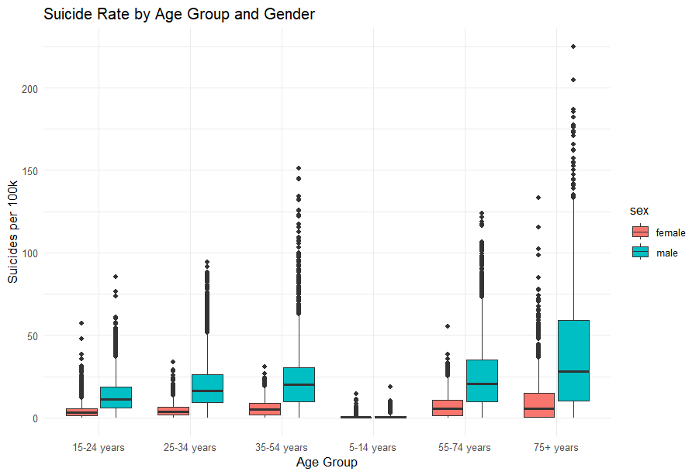
Data Analysis
Interpretation:
Males have significantly higher suicide rates across all age groups.
Risk increases sharply with age, peaking in the 75+ group.
Females show lower and more consistent suicide rates.
The 35–54 and 75+ age brackets display the widest spread in male suicide rates.
Young children (5–14) have the lowest overall suicide rates.
Significance:
Boxplot visualizing suicide rates by age group and gender across global records.
Highlights why age and gender were key features in XGBoost’s accurate suicide risk predictions.

Slide 5

Methodology
Data Preprocessing:
Cleaned GDP and removed missing suicides/100k
Categorical encoding with model.matrix()
Created suicide_risk_level as a new target
Model Setup:
70/30 stratified split
Converted data to DMatrix (optimized for XGBoost)
Trained over 100 rounds
Output:
Probabilities per class (multi:softprob)
Predicted class via max.col()

Slide 6
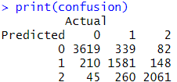
Performance & Key Insights
Accuracy: ~87% on test set
Top predictors: Age group, GDP per capita & Gender
This confusion matrix shows XGBoost achieved strong multiclass accuracy, especially in correctly predicting high-risk suicide cases.
Recommendations:
Prioritize mental health interventions for males aged 55+
Incorporate real-time GDP and socio-political indicators in future models
Deploy predictive dashboards to health organizations for early warnings
Collaborate with governments to integrate ML insights into public health policy

Slide 7
Random Forest
Objective:
Classify gender based on suicide-related variables like age group, generation, GDP per capita, and suicide rate per 100k population.
Why Random Forest?
An ensemble model built from multiple decision trees.
Robust to noise and handles large datasets effectively.
Great for classifying complex, real-world patterns.
Provides feature importance scores, enhancing interpretability.
Avoids overfitting by using bagging and randomness.
Parameters Used:
A Random Forest classifier was trained using 200 trees (ntree = 200) and 3 randomly selected features per split (mtry = 3) to predict gender (sex).

Slide 8
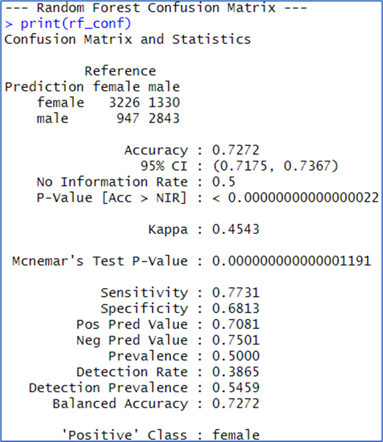
Methodology
Data Preprocessing:
Removed HDI due to >70% missing data.
Converted sex, age, generation to factor variables.
Selected features: suicides/100k, gdppercapita, age, generation
Model Configuration:
Trained with randomForest() using:
ntree = 200, mtry = 3
70/30 train-test split using createDataPartition()
Output Performance:
Accuracy: 72.72%
Sensitivity (Female): 77.31%
Specificity (Male): 68.13%
Kappa Score: 0.4543
Balanced Accuracy: 72.72%

Slide 9
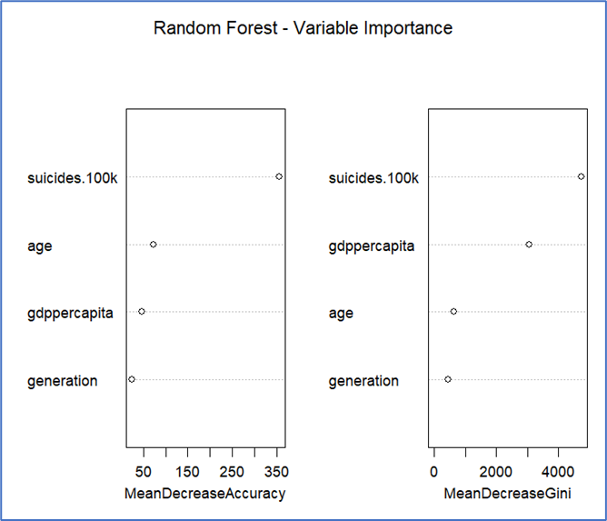
Interpretation & Key Insights
Insights from Variable Importance Plot:
Suicides per 100k is the most influential predictor
GDP per capita and age follow in importance
Generation has minimal impact due to overlap with age
Conclusion:
Random Forest model outperforms Decision Tree in overall balance and accuracy.
Stronger at handling demographic variability and data noise
Reliable for predicting gender from suicide trends, especially for females
Useful in informing gender-sensitive public health strategies
Output Performance:
Variable Importance Plot from Random Forest Model: Highlighting Dominant Predictors of Gender Classification
Apply SMOTE to address class imbalance
Add variables like urbanization or healthcare access
Explore deep learning models for deeper pattern recognition

Slide 10
Support Vector Machine (SVM)
Objective:
Use demographic and economic variables to classify suicide rates into Low, Medium, or High risk levels using SVM.
Why SVM?
Excels at non-linear classification using kernel functions.
Handles high-dimensional, scale-sensitive features well.
Ideal for multi-class problems like suicide risk levels.
Leverages maximum-margin hyperplanes to separate classes.
Highly effective with demographic and economic data.
Parameters Used:
SVM models trained using:
Linear, Radial (RBF), and Polynomial (degree = 3) kernels
Classification target: suicide_rate_cat (Low, Medium, High)

Slide 11
Methodology
Data Preprocessing:
Selected key variables and renamed columns (e.g., suicide_rate)
Created new variable suicide_rate_cat using cut()
Encoded all categorical predictors using dummyVars()
Applied scaling and centering for SVM kernel stability
80/20 stratified train-test split using createDataPartition()
Model Setup:
Built three SVM models using linear, radial, and polynomial kernels
Predictions made on test data to compare model performance
Evaluated using accuracy, Kappa, and confusion matrix
Output:
Linear Kernel:
Accuracy: 99.57%
Kappa: 0.992
Radial Kernel:
Accuracy: 97.27%
Kappa: 0.9488
Polynomial Kernel:
Accuracy: 96.93%
Kappa: 0.9424

Slide 12
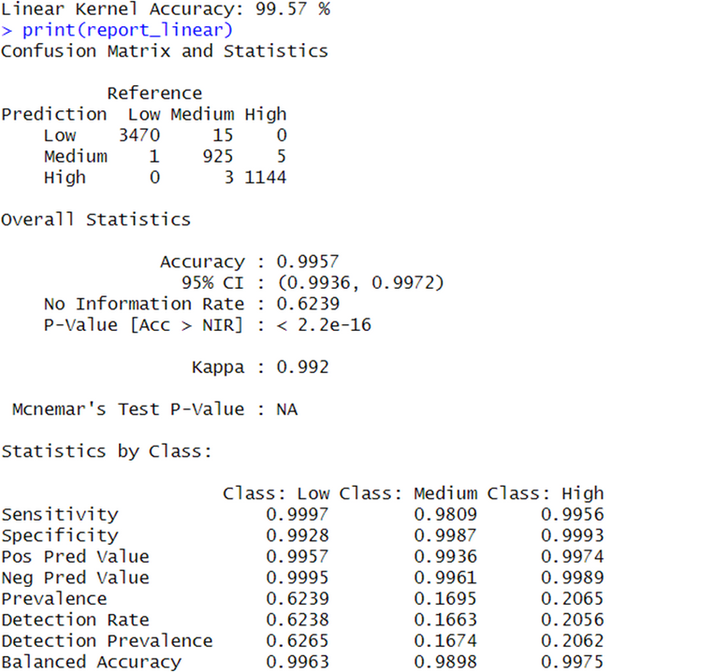
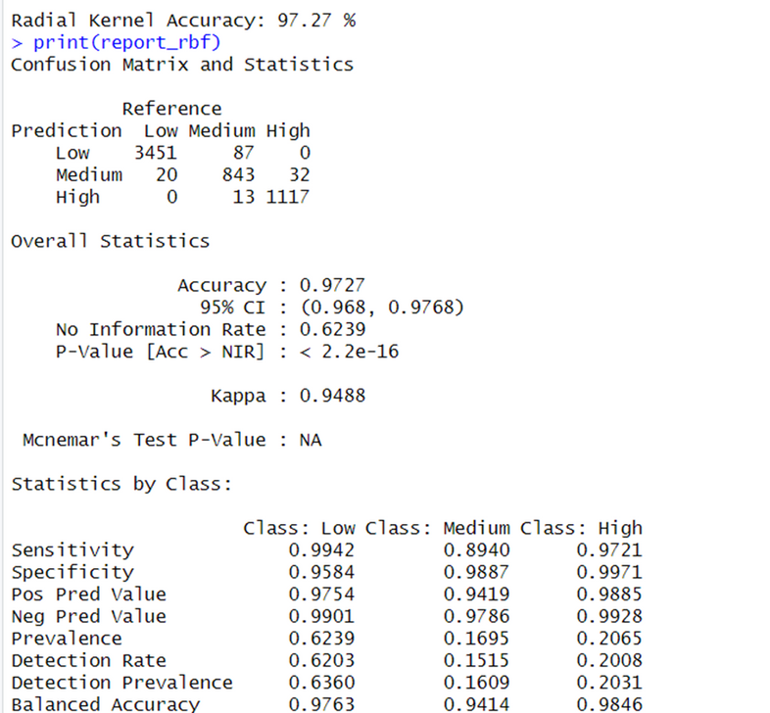
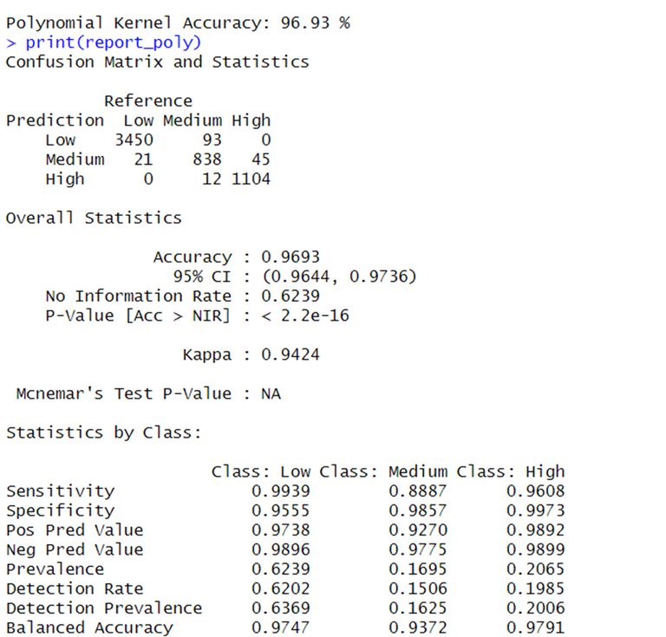
Outputs
Linear Kernel
Radial Kernel
Polynomial Kernel
Accuracy: 99.57%
Kappa: 0.992
Accuracy: 97.27%
Kappa: 0.9488
Accuracy: 96.93%
Kappa: 0.9424

Slide 13
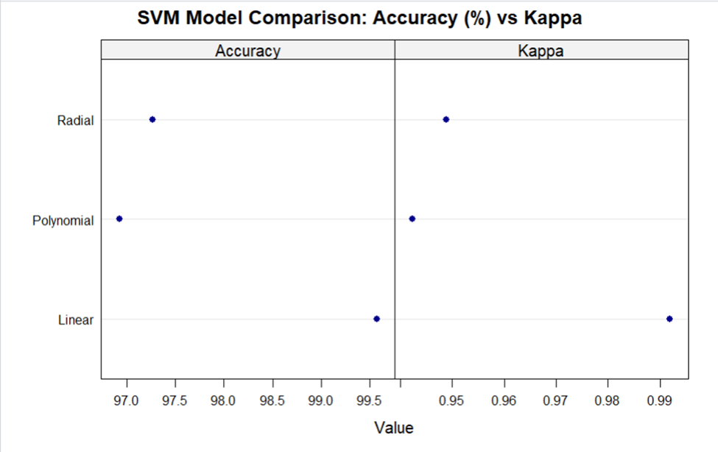
Interpretation & Key Insights
Insights from Comparative Performance:
Linear kernel delivered the highest performance, minimal overfitting.
Sex and age were most influential predictors
Models handled multi-class classification with exceptional accuracy.
GDP per capita required scaling due to skewness, affecting kernel margins.
Conclusion:
SVM, especially with a linear kernel, is highly suitable for classifying suicide risk.
Offers strong model generalization and interpretability.
Supports reliable, data-driven decision-making in mental health analytics.
SVM Model Comparison: Accuracy (%) vs Kappa
Recommendations:
Use Linear SVM for suicide risk classification tasks
Enhance inputs with urbanization, healthcare access,
or mental health funding

Slide 14
K-Means Clustering
Objective:
Cluster global suicide data using GDP, HDI, suicides per 100k, and population to reveal underlying risk patterns.
Why K-Means?
Groups data based on similarity in numerical features.
Unsupervised learning algorithm — no labels required.
Segments records into clusters based on proximity.
Efficient and scalable for large datasets.
Identifies hidden patterns in complex data.
Parameters Used:
K-Means models trained using:
2 clusters and 3 clusters.
Optimal number of clusters determined using Elbow Method.
Evaluated with BSS/TSS ratio and WSS stabilization.

Slide 15
Methodology
Data Preprocessing:
Filtered dataset to retain only rows with valid HDI.
Selected numerical features for clustering.
Removed non-numeric columns, dropped missing values.
Focused on variables like GDP per capita, population, HDI, and suicides/100k.
Model Setup:
Performed clustering with:
k = 2 and k = 3 using kmeans()
Evaluated quality of partition using BSS / TSS
Used fviz_nbclust() to apply the Elbow Method
Optimal number of clusters: 3

Slide 16


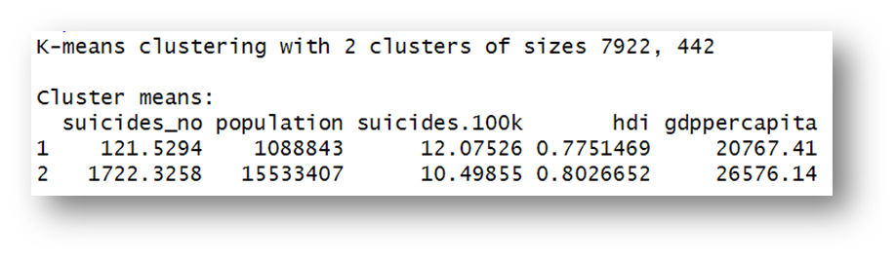
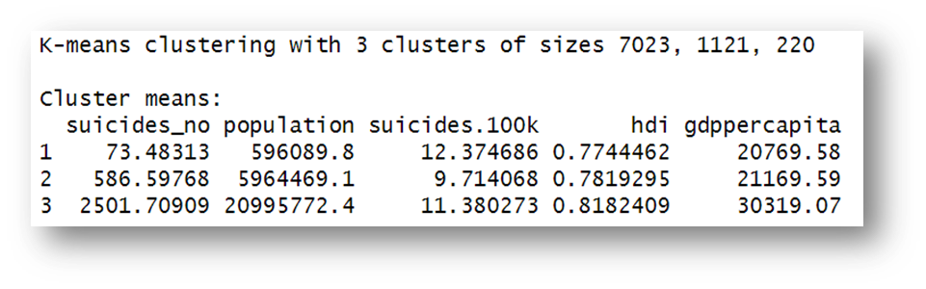
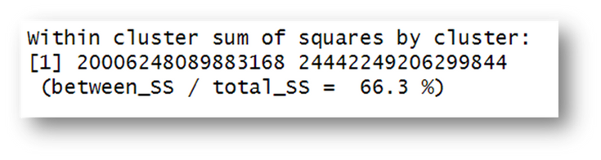
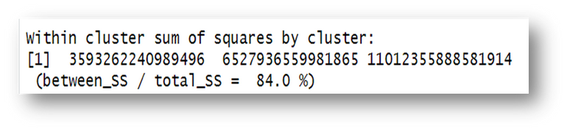
Data Analysis
2-Clusters
3-Clusters

Slide 17
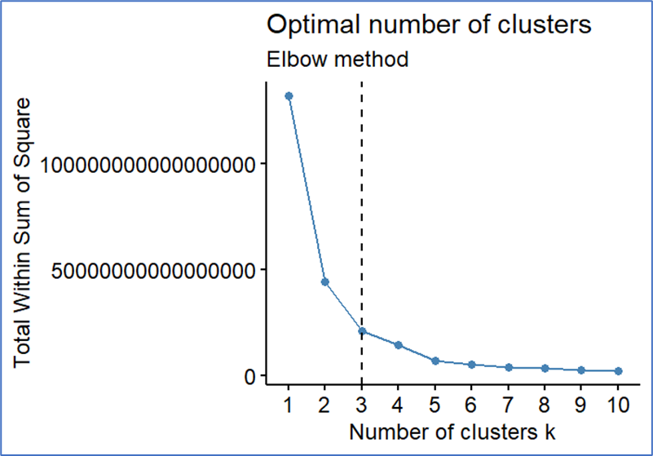
Elbow Method
Interpretation:
The elbow plot helps identify the optimal number of clusters by observing where the WSS curve bends.
Here, the "elbow" at k = 3 indicates that a 3-cluster model best captures variation without overfitting.
Conclusion:
From clustering suicide data using HDI, GDP, population, and suicides per 100K, we observe:
Higher HDI is linked to lower suicide rates.
Cluster 1 contains high-risk, low-HDI nations
K-Means highlights how development gaps influence mental health outcomes globally
Elbow plot determining optimal number of clusters (k = 3) for K-Means clustering.
Recommendations for Stakeholders:
WHO should focus on raising HDI in Under developed Countries.
Intervene via education, healthcare, and income equity.

Slide 18
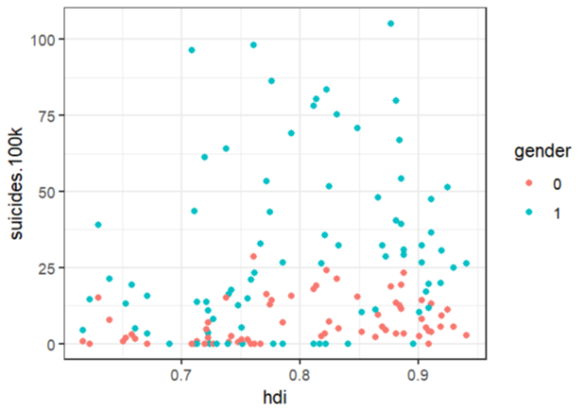
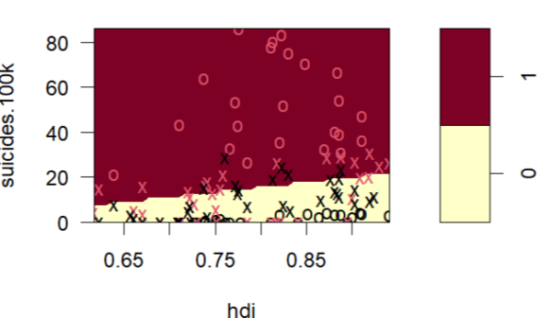
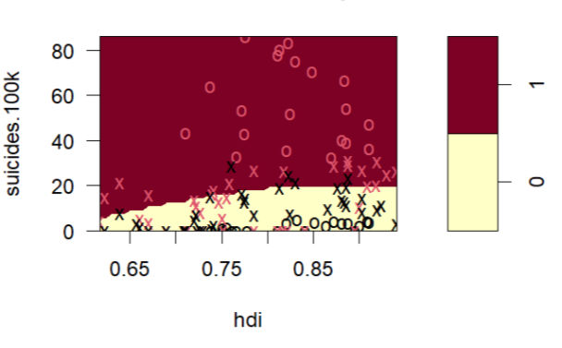
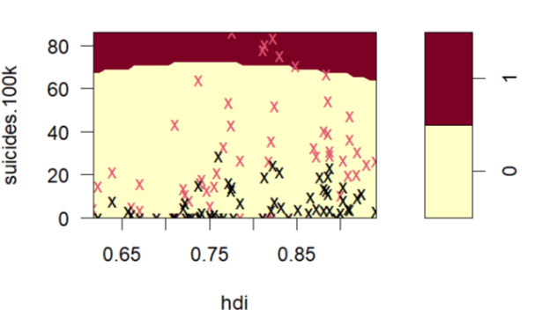
Gender Classification for Age > 75+ years
Data Context:
Analyzed subset of data for individuals aged 75+
X-axis: HDI | Y-axis: Suicides per 100k
Red: Female (gender = 0) | Blue: Male (gender = 1)
Interpretation:
Males consistently show higher suicide rates than females in this age group
High suicide rates are most prominent in low-to-mid HDI range
Despite HDI improvements, male risk remains significantly elevated
Linear Kernel: 78% accuracy
Radial Kernel: 80% accuracy
(γ=0.1, cost=2.5)
Polynomial Kernel: 58% accuracy

Slide 19
Decision Tree
Objective:
Classify whether a country-year’s suicide rate is "High" or "Low" based on age, sex, HDI, and GDP per capita
Why Decision Tree?
Splits data into interpretable rules based on predictors
Handles mixed data types and categorical features well
Easy to visualize and explain to non-technical stakeholders
Automatically identifies important variables and optimal thresholds
Pruning reduces overfitting and improves model generalization
Parameters Used:
Built using rpart()
Pruned using complexity parameter (CP) with lowest xerror
Target variable: rate_class (binary: High / Low)

Slide 20
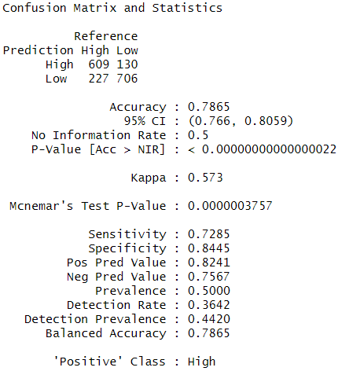
Methodology
Data Preprocessing:
Removed records with missing HDI or suicide rate.
Created new binary label: rate_class (above or below median suicide rate)
Selected predictors: sex, age, generation, GDP per capita, and HDI.
80/20 train-test split using createDataPartition().
Model Setup:
Initial tree built using rpart().
Tree pruned using optimal CP value to reduce overfitting.
Final tree visualized using rpart.plot().
Output:
Accuracy: 78.65%
Sensitivity (High): 72.85%
Specificity (Low): 84.45%

Slide 21
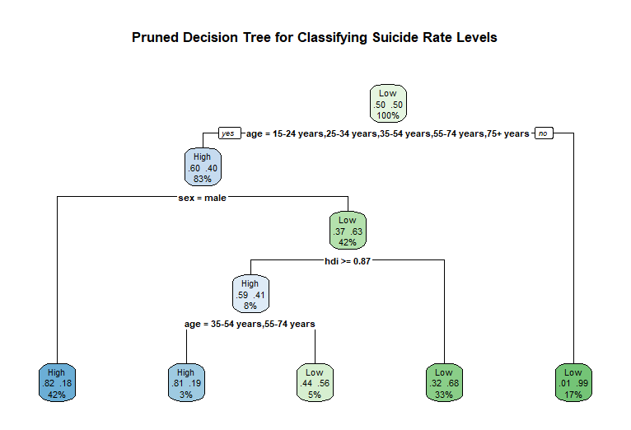
Interpretation & Key Insights
Insights from Tree Structure & Data Patterns:
Age is the strongest predictor: older individuals more likely in "High" group.
Sex matters: males significantly more at risk in higher age brackets.
HDI reduces risk, particularly among females in developed regions.
Conclusion:
Decision Tree successfully classified suicide risk using core demographics and socio-economic data.
The tree confirms patterns seen in EDA: older males in low-HDI nations are highest risk.
Pruned decision tree classifying suicide rate levels based on age, sex, and HDI.

Slide 22
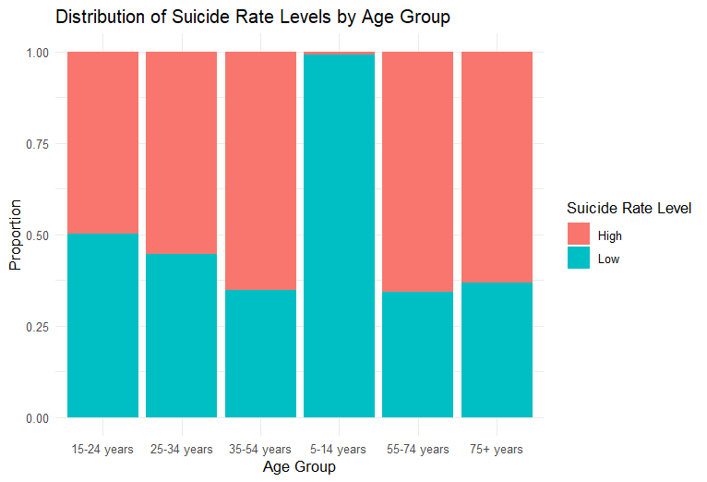
Data Analysis
Interpretation:
5–14 age group is entirely classified as low-risk, indicating minimal suicide rates.
Suicide risk increases steadily with age, especially from 35 years onward.
The 35–54 and 55–74 age groups have a higher proportion of high-risk cases.
Even in the 75+ group, risk remains elevated — nearly half fall into the high-risk category.
Younger age groups (15–24 and 25–34) are relatively balanced between high and low risk.
Significance:
Stacked bar chart showing the proportion of high vs. low suicide rates across age groups.
Reveals that age is a major determinant of suicide risk classification — critical for prioritizing age-specific mental health interventions in decision tree models.

Slide 23
Key Insights
High-Risk Group: Older males (especially 55+) consistently emerge as the most at-risk group for suicide across models, irrespective of income level.
HDI vs. GDP: Human Development Index (HDI) has a stronger correlation with suicide rates than GDP per capita, highlighting the role of education, healthcare, and life expectancy.

Slide 24
Conclusion
This study demonstrates the critical role of data mining in understanding global suicide patterns. Machine learning models, especially XGBoost and clustering methods, proved effective in identifying high-risk demographics and uncovering complex interplays between age, gender, and socioeconomic indicators. The findings highlight that suicide prevention requires more than economic growth—it demands targeted, culturally sensitive interventions grounded in data. By combining predictive modeling with qualitative insights and real-time monitoring tools, stakeholders can develop more responsive, evidence-based strategies to address mental health challenges worldwide.

Slide 25
References
BLUMAN, A. (2022). Elementary Statistics: A Step-by-Step Approach. McGraw-Hill US Higher Ed USE. http://ebookcentral.proquest.com/lib/northeastern-ebooks/detail.action?docID=7052050
Suicide. (n.d.). Retrieved April 22, 2025, from https://www.who.int/news-room/fact-sheets/detail/suicide
kabacoff. (2024). Kabacoff/RiA2 [R]. https://github.com/kabacoff/RiA2 (Original work published 2015)

Slide 26
Thank you

